Slide 1
Research Communication Skills
Reading Research Papers

Slide 2
How to read papers?
Do we read all the papers that we find?
Do we read all the sections for all the papers that we collect?
Do we read the sections of the paper in the same order that they are printed?

Slide 3
How to read papers?
Pick a strategy that works for you
  Based on your experience
  Depending on the purpose of paper reading (what questions do you want to answer when reading the paper?)

Slide 4
Do we read all the papers that we find?

Slide 5
How many papers are there?
Networking Conferences example (from: N. Feamster, A. Gray, “Reading and Reviewing Papers”):
  – SIGCOMM: ~ 40 papers
  – SIGMETRICS: ~ 20 papers
  – IMC: ~ 40 papers
  – CoNext: ~ 30 papers
  – ICNP: ~ 30 papers
  – Infocom: ~ 100 papers – Journals, workshops, …
Per year: More than 2,000 pages to read
Impossible to read it all… – doesn’t even count cross-disciplinary reading

Slide 6
Types of research papers
Conference papers
  Most recent, hot off the press information
Technical reports
  Expand on the information in a conf. paper
Workshop papers
  Very hot/new topics, work in progress, preliminary results and ideas
Journal papers (a.k.a. articles)
  Expand and combine results from several conference papers
Book chapters
  Expand a conference or journal paper

Slide 7
Types of papers
Theoretical
  Describe / prove a theory / algorithm
Engineering
  Describe an implementation of an algorithm, or part or all of a computer system or application
Empirical
  Describe an experiment designed to test some hypothesis
Survey
  Review recent results in a field of research

Slide 8
Deciding what to read
Depending on the purpose of reading
  Purpose: Learn about “hot topics” of current research in an area. (searching for problems, etc.)
    Scan papers in latest conference proceedings
  Purpose: Get up to speed on sub-field
    Transitive closure of related work of papers in a top conference – find “related works” section in your papers
  Purpose: Learn about an area that is further afield
    Ask expert colleagues

Slide 9
Deciding what to read
Depending on the purpose of reading
  Purpose: Learn about “hot topics” of current research in an area. (searching for problems, etc.)
    Scan papers in latest conference proceedings
  Purpose: Get up to speed on sub-field
    Transitive closure of related work of papers in a top conference – find “related works” section in your papers
  Purpose: Learn about an area that is further afield
    Ask expert colleagues

Slide 10
Deciding what to read
Depending on the purpose of reading
  Purpose: Learn about “hot topics” of current research in an area. (searching for problems, etc.)
    Scan papers in latest conference proceedings
  Purpose: Get up to speed on sub-field
    Transitive closure of related work of papers in a top conference – find “related works” section in your papers
  Purpose: Learn about an area that is further afield
    Ask expert colleagues

Slide 11
Deciding what to read
Depending on the purpose of reading
  Purpose: Learn about “hot topics” of current research in an area. (searching for problems, etc.)
    Scan papers in latest conference proceedings
  Purpose: Get up to speed on sub-field
    Transitive closure of related work of papers in a top conference – find “related works” section in your papers
  Purpose: Learn about an area that is further afield
    Ask expert colleagues

Slide 12
Deciding what to read
Depending on the purpose of reading
  Purpose: Learn about “hot topics” of current research in an area. (searching for problems, etc.)
    Scan papers in latest conference proceedings
  Purpose: Get up to speed on sub-field
    Transitive closure of related work of papers in a top conference – find “related works” section in your papers,
  Purpose: Learn about an area that is further afield
    Ask expert colleagues

Slide 13
    Transitive closure of related work of papers in a top conference – find “related works” section in your papers

Slide 14
    Transitive closure of related work of papers in a top conference – find “related works” section in your papers
Related work section of a paper I am reading
Related works of this paper

Slide 15
Transitive closure of related work of papers in a top conference – find “related works” section in your papers

Slide 16
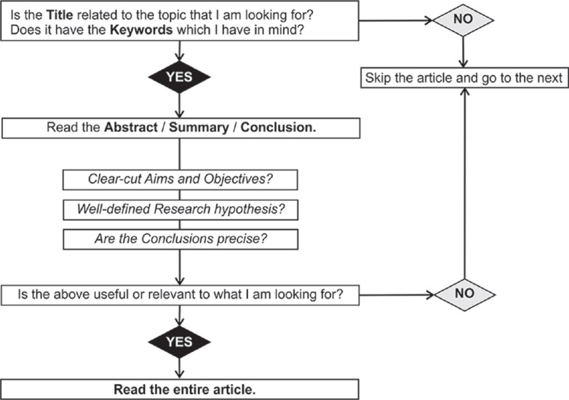
Decision-making flowchart to decide whether to read the chosen article or not

Slide 17
How to read papers?
Do we read all the sections for all the papers that we collect?
Do we read the sections of the paper in the same order that they are printed?

Slide 18
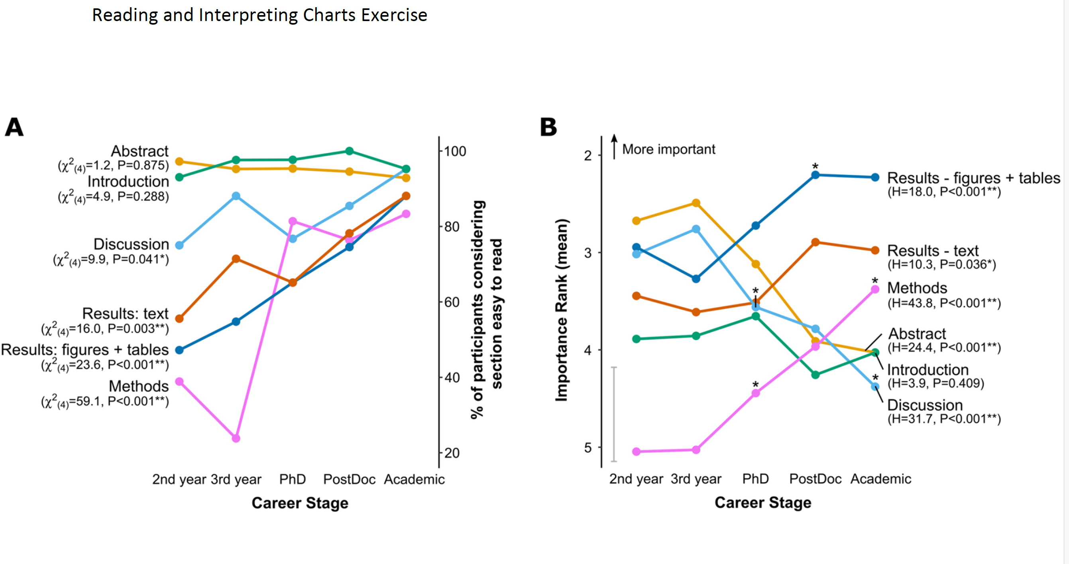
Exercise 2

Slide 19
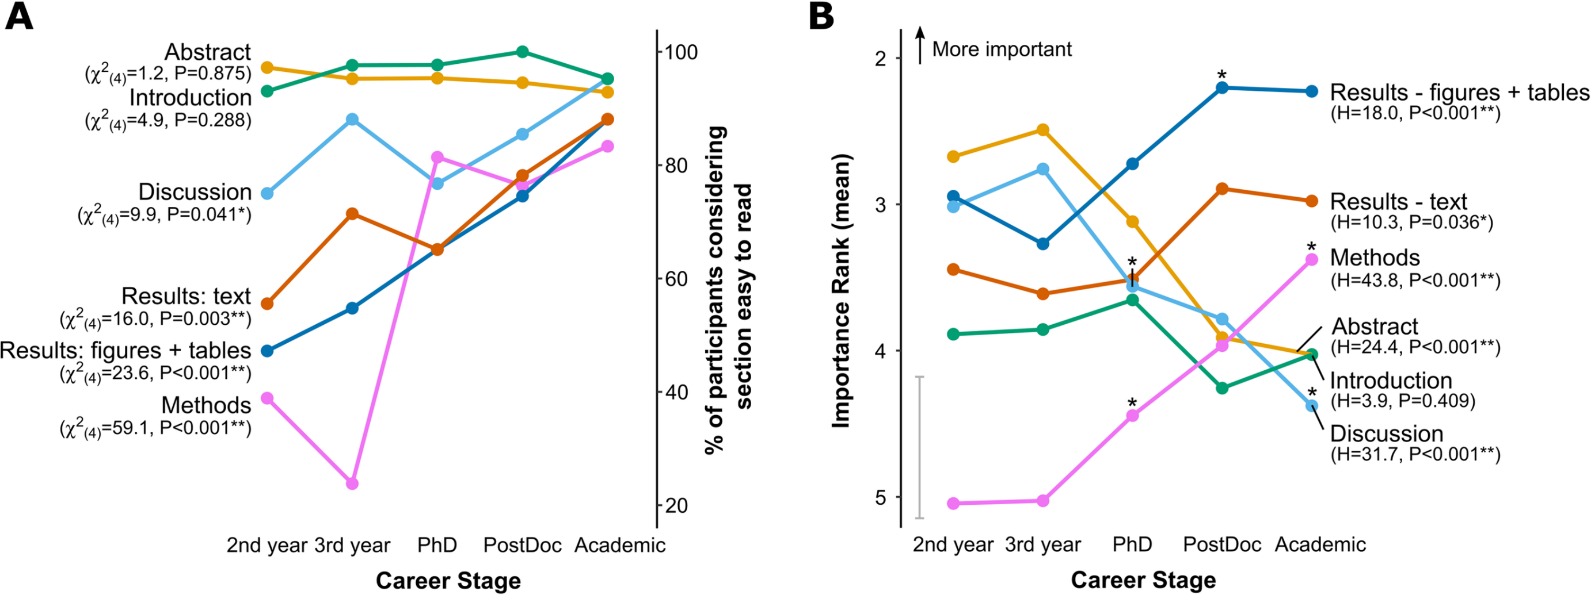
Paper sections reading statistics
[1] Hubbard, K. E., & Dunbar, S. D. (2017). Perceptions of scientific research literature and strategies for reading papers depend on academic career stage.

Slide 20
Paper sections reading statistics
[1] Hubbard, K. E., & Dunbar, S. D. (2017). Perceptions of scientific research literature and strategies for reading papers depend on academic career stage.

Slide 21
Paper sections reading statistics
[1] Hubbard, K. E., & Dunbar, S. D. (2017). Perceptions of scientific research literature and strategies for reading papers depend on academic career stage.

Slide 22
Deciding How to Read
Always “top down”
  First: Abstract, introduction, conclusion
  Rest of the paper if necessary
    If you want to do follow-up research
    If you want to better understand the methods/conclusions
    …

Slide 23
Quick reading of the paper
Read abstracts, headings and subheadings.
Make note of charts, statistics, graphs.
Read the reference lists.
Read introductory and summary paragraphs.
Skim body.

Slide 24
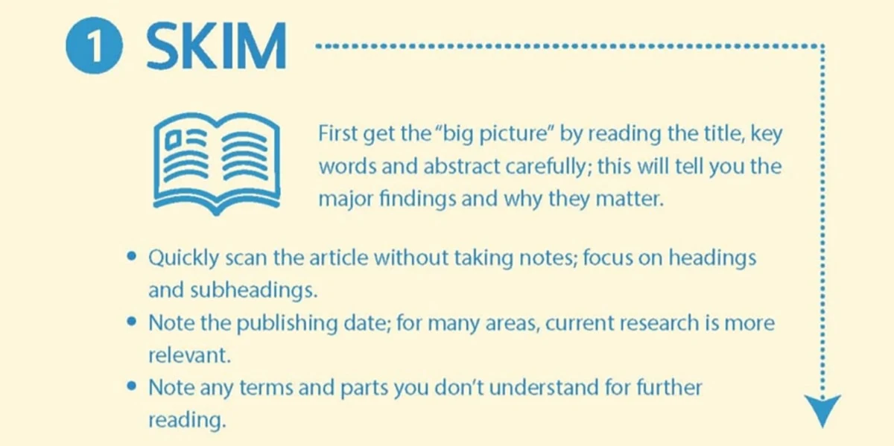

Slide 25
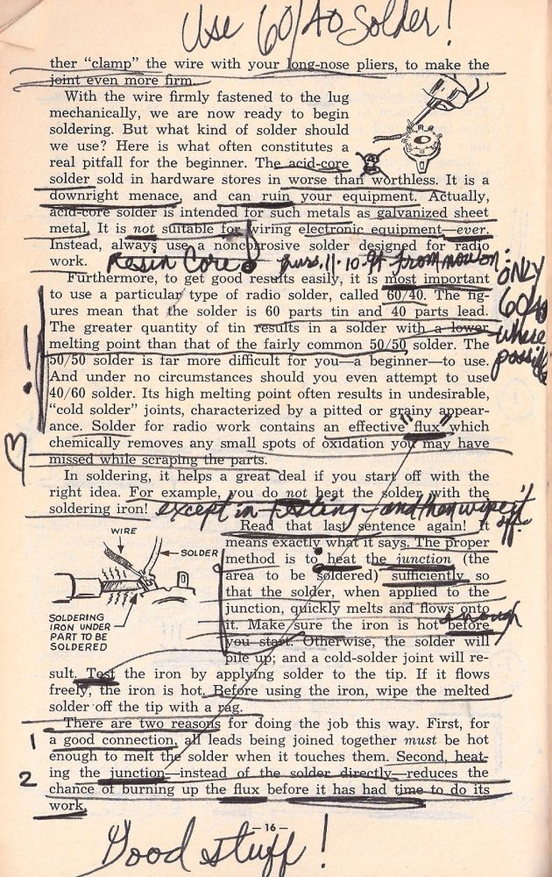

Slide 26
Reading Tip - take notes while you read:
Underlining, marking, highlighting
  mark major points, definitions, and theorems for quick reference later
Notes in the margins
  write down questions as they pop into your head
  answer previous questions as you find answers
  summarize tables, graphs, etc.
  add details to incomplete/unclear examples
Develop a system that is meaningful to you.

Slide 27
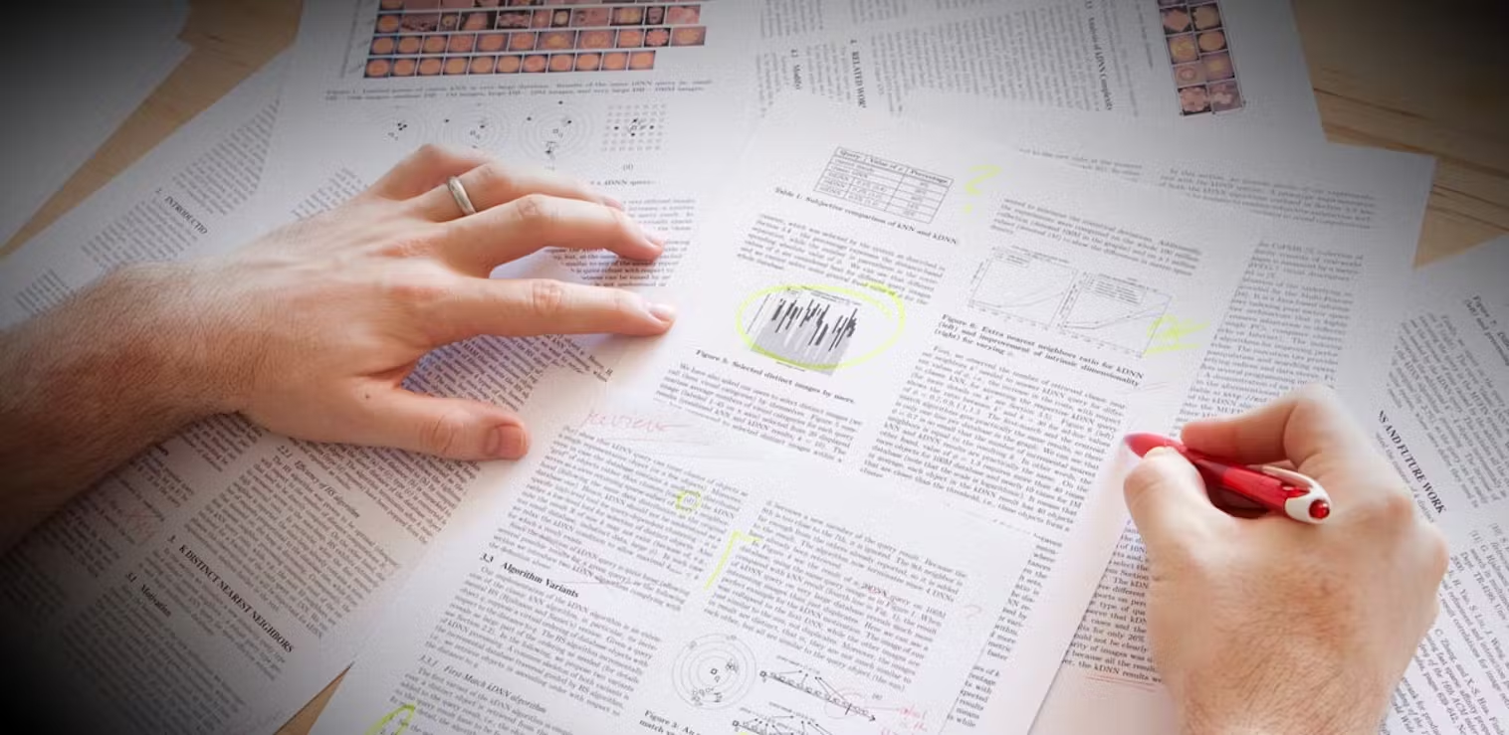

Slide 28
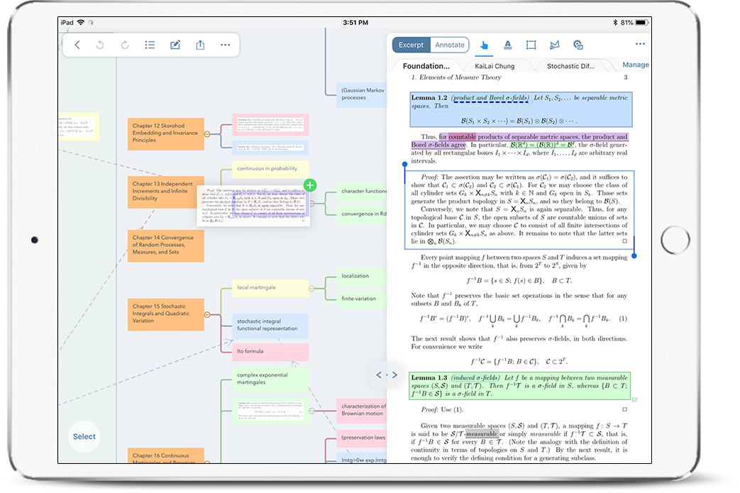

Slide 29
Reading Tip - take notes after you read:
For each paper, write up:
A technical summary of the work
A brief description of the paper’s relation to other works
Relationships to your ongoing/planned research
Any ideas for future work that come to mind

Slide 30
Developing understanding of the paper (1)
Go through the paper word by word and line by line, underlining or highlighting every word and phrase you don't understand. Don't worry if there are a lot places with underlining; you're still not trying to make sense of the article.

Slide 31
Developing understanding of the paper (2)
After skimming the paper and noting words and phrases you do not understand, it is helpful to read the paper again, noting the things that you DO understand. You may underline or highlight the text, then write a clarifying note in the margin.
In the “Introduction,” for example, restate the problem and the research question(s) in the margin or in your notebook.
Over the next few “readings” of the paper, your task is to identify what you do and do not understand about the research.

Slide 32
Developing understanding of the paper (3)
Clarify the words and concepts you do not understand
  Look up simple words and phrases. Search web sites for clarification. Be sure to search more than one source and critically compare. Your ordinary dictionary may not be a good source, because the definitions may not be precise enough or may not reflect the way in which scientists use a word.
  Get an understanding from the context in which an unknown word or phrase is used. Often words that are used to describe the procedures used in an experiment can be understood from the context, and may be very specific to the paper you are reading.

Slide 33
The Three-Pass Method (Keshav)
http://ccr.sigcomm.org/online/files/p83-keshavA.pdf
Pass 1
  General idea
Pass II
  Basic content, but not details
Pass III
  In depth understanding

Slide 34
Reading a paper: Pass I
Bird’s eye view: 5-10 minutes
  Title, abstract, introduction
  Section and subsection headings
  Conclusions
  Glance over references

Slide 35
After Pass I
You should be able to answer 5C questions:
Category
  What type of paper is it ?
Context
  What other papers is it related to ?
Correctness
  Are the assumptions valid ?
Contributions
  What are the main contributions ?
Clarity
  Is the paper well written ?
Q - Why are we sure that there is enough information in these several sections to answer these 5 questions?
A -
Paper writing process
Paper review process

Slide 36
Reading a paper: Pass II
Read carefully, but ignore details (e.g. proofs, complicated formulas, etc.)
~1hour
  Identify key points, or make comments in the margins
  Figures, diagrams, illustrations, graphs
    Properly labeled? error bars? etc.
  Mark relevant unread references

Slide 37
After Pass II
Sometimes, you still don’t understand the paper
  subject is new to you, unfamiliar terminology and acronyms
  proof or experimental technique that you don’t understand
  poorly written, unsubstantiated assertions and numerous forward references
  it’s late at night and you are tired

Slide 38
After Pass II
Three choices:
  set the paper aside
    hope that you don’t need to understand the paper to be successful in your career
  return to the paper later
    perhaps after reading background material –> (re)search
  go on to Pass III

Slide 39
Reading a paper: Pass III
Fully understand the paper
  1(experienced)-5(newcomer) hours
  Great attention to detail
  Virtually re-implement the paper
  Using same assumptions, recreate the work
  Identify and challenge every assumption in every statement
  Jot down ideas for future works

Slide 40
After Pass III
You should be able to reconstruct the entire structure of the paper from memory
You should be able to identify its strong and weak points
You should be able to pinpoint implicit assumptions, missing citations to relevant work, and potential issues with experimental or analytical techniques

Slide 41
Comprehension Questions
While reading the paper, look for answers to these questions:
  What is the problem?
  What are the contributions?
    New finding ?
    New method ?
    New perspective ?
  What are the conclusions?
  What is the support for the conclusions?

Slide 42
Summary
Reading and understanding a scientific paper is not easy. In most cases you do not have all the background knowledge required to understand a paper
Understanding a paper is not a yes/no condition: you must decide when you have a reasonably good understanding of the content

Slide 43
More resources
https://www.sciencemag.org/careers/2016/03/how-seriously-read-scientific-paper
  a dozen scientists at different career stages and in a broad range of fields tell about their approach to reading research papers
https://www.ncbi.nlm.nih.gov/pmc/articles/PMC3687192/
  medical sciences
2 papers in the WeChat group

